Slide 1
inTASC Standard 2:
Learning Differences
Joel Michael Pope

Slide 2
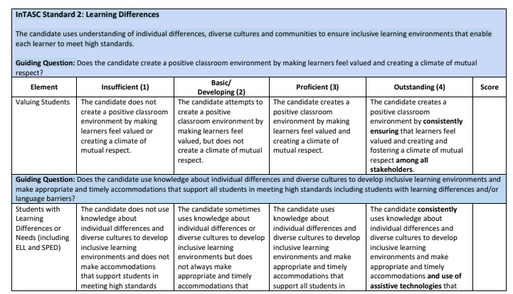
What is the Standard?
All students are valued, listened to and respected, no matter what their background.
Classroom is inclusive！
Diverse factors including background and culture as well as learning aptitude taken into consideration

Slide 3
My Personal Interpretation:
- Students are allowed to be themselves. Their personality and identify is respected and accommodated.
The balance between these together.
- At the same time, a sense of community, collaboration and welcome within the class as the whole.

Slide 4
My Personal Interpretation:
- Students are allowed to be themselves. Their personality and identify is respected and accommodated.
The balance between these together.
- At the same time, a sense of community, collaboration and welcome within the class at the whole.
- Also, differentiation on the class based on multiple factors.

Slide 5
How Would I See This Standard in My Classroom?

Slide 6
How Would I See This Standard in My Classroom?
- Differences in culture, background and language, including between teacher and students. However, working together and lots of shared experiences everyday.
- A range of activities and ways to express ourselves and develop our skills.
- Supporting each other with language development.
- Lots of opportunities to share experiences from home and perhaps eventually also, information about our cultures.

Slide 7
Strategies to Show Evidence of This Standard

Slide 8
Strategies to Show Evidence of This Standard
Take the time to get to know information about your student’s backgrounds, through background research as well as talking to them. If you can show that you know your students and their interests through the activities and examples you incorporate, you are doing well.
- Allow real opportunities for students to provide feedback and share thoughts and feelings.
- Very short activities or circle times, in which students get to share something important to them. Can be done in a whole group if no time for the whole class.
- Create time, activities and projects for shared experiences in the classroom. This is why group work and activities involving social development can be so important.
- Differentiation on product, process, environment and content, as well as student choice.

